Slide 1
Mathematical Preliminaries

Slide 2
Mathematical Preliminaries
Sets
Functions
Relations
Graphs
Proof Techniques

Slide 3
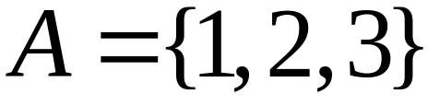

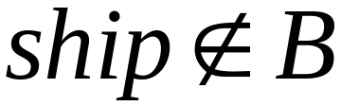
SETS
A set is a collection of elements
Membership

Slide 4
Set Representations
  C = { a, b, c, d, e, f, g, h, i, j, k }
  C = { a, b, …, k }
  S = { 2, 4, 6, … }
finite set
infinite set

Slide 5
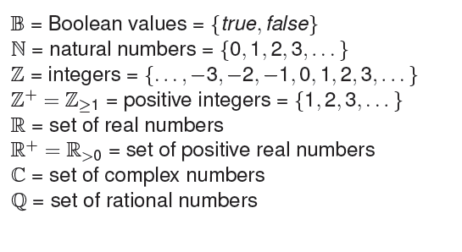
Some important sets

Slide 6
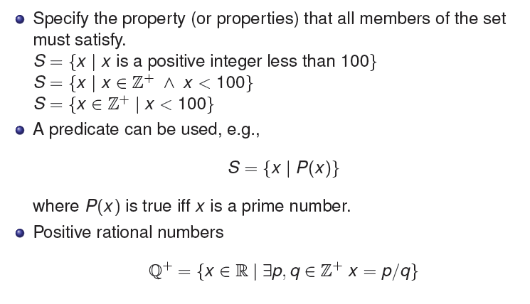
Set Representations

Slide 7
Set Representations
Order not important
S = {a, b, c, d} = {b, c, a, d}.
Listing more than once does not change the set.
S = {a, b, c, d} = {a, b, c, b, c, d}.

Slide 8
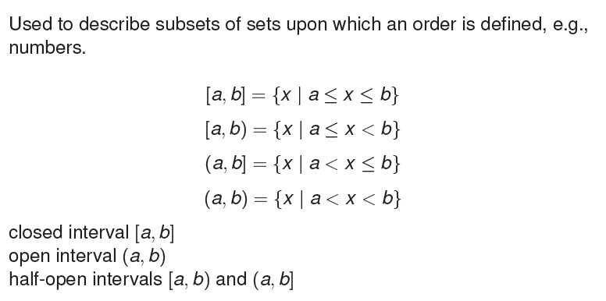
Interval Notations

Slide 9
Universal Set
A universal set is the collection of all objects in a particular context or theory.
Depends the context or theory under consideration.
For example, we might define U as the set of all living things on planet earth. In that case, the set of all dogs is a subset of U, the set of all fish is another subset of U, and the set of all trees is yet another subset of U.

Slide 10
U = { 1 , … , 10 }
A = { 1, 2, 3, 4, 5 }
U
6
A
2
8
1
3
7
4
5
9
10

Slide 11
Set Operations
A = { 1, 2, 3 } B = { 2, 3, 4, 5}
Union
A U B = { 1, 2, 3, 4, 5 }
Intersection
    A B = { 2, 3 }
Difference
    A - B = { 1 }
    B - A = { 4, 5 }
A
B
2
4
1
3
5
U
2
3
1
Venn diagrams

Slide 12
Complement
      Universal set = {1, …, 7}
      A = { 1, 2, 3 } A = { 4, 5, 6, 7}
4
A
A
6
1
3
2
5
7
A = A

Slide 13
{ even integers } = { odd integers }
Integers
1
odd
0
5
even
2
6
4
3
7

Slide 14
DeMorgan’s Laws
A U B = A B
U
A B = A U B
U

Slide 15
Empty, Null Set:
= { }
S U = S
S =
S - = S
- S =
U
= Universal Set

Slide 16
Singleton set
A singleton, also known as a unit set, is a set with exactly one element.
For example, the set {0} is a singleton.

Slide 17
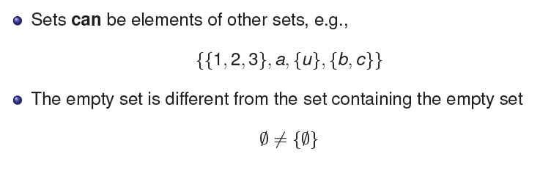
To Remember

Slide 18
Subset
A = { 1, 2, 3} B = { 1, 2, 3, 4, 5 }
U
A B
Proper Subset:
U
A B
B
A

Slide 19
Disjoint Sets
A = { 1, 2, 3 } B = { 5, 6}
A B =
U
A
B

Slide 20
Set Cardinality
For finite sets
A = { 2, 5, 7 }
|A| = 3
(set size)

Slide 21
Powersets
A powerset is a set of sets
S = { a, b, c }
Powerset of S = the set of all the subsets of S
2^{S} = { , {a}, {b}, {c}, {a, b}, {a, c}, {b, c}, {a, b, c} }
Observation: | 2^{S} | = 2^{|S|} ( 8 = 2³ )

Slide 22
Cartesian Product
A = { 2, 4 } B = { 2, 3, 5 }
A X B = { (2, 2), (2, 3), (2, 5), ( 4, 2), (4, 3), (4, 5) }
|A X B| = |A| |B|
Generalizes to more than two sets
A X B X … X Z

Slide 23

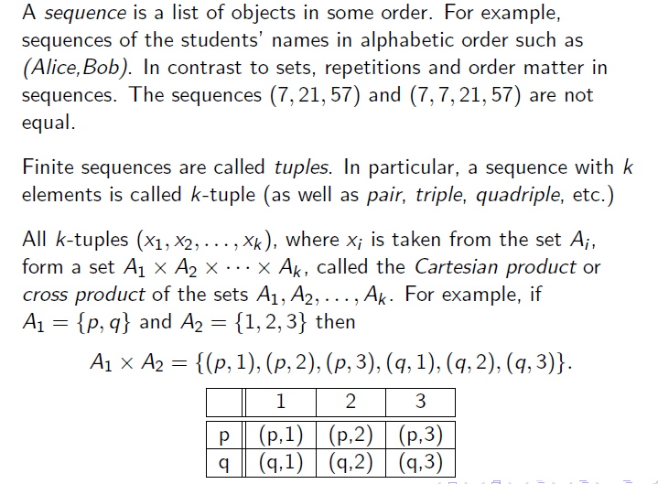
Sequences and Tuples

Slide 24
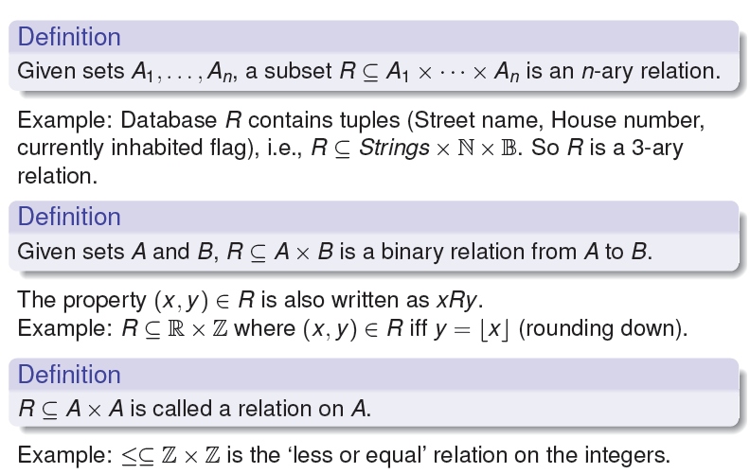
Relations

Slide 25
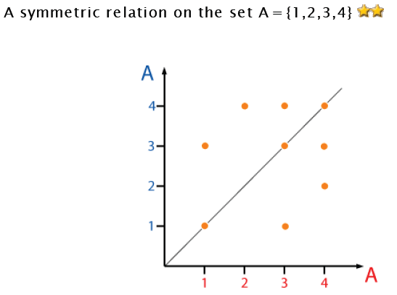
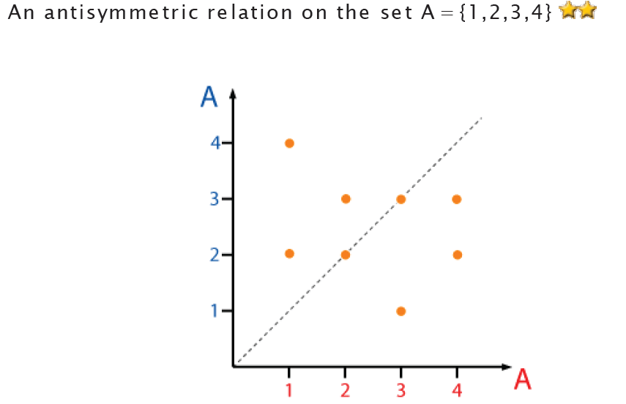
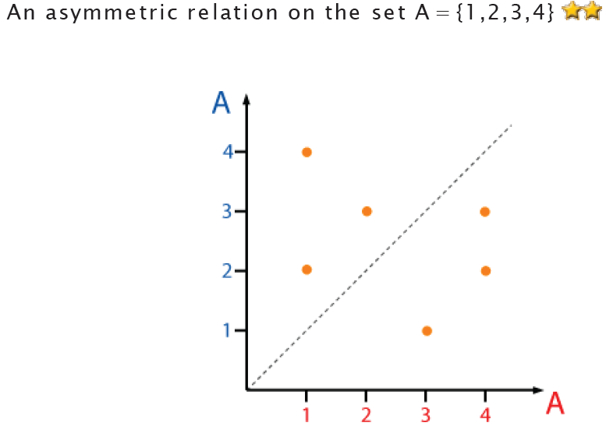
Relations

Slide 26
Equivalence Relations
Reflexive: x R x
Symmetric: x R y y R x
Transitive: x R y and y R z x R z
Example: R = ‘=‘
x = x
x = y y = x
x = y and y = z x = z

Slide 27

Equivalence Relation

Slide 28
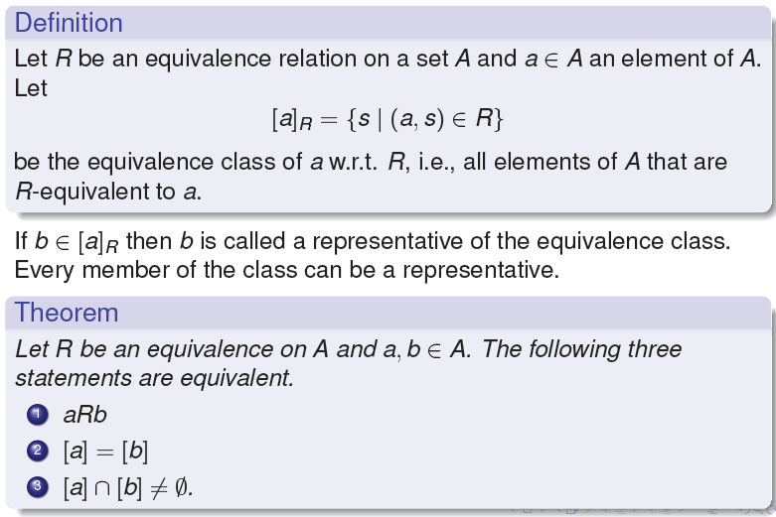
Equivalence Classes

Slide 29
Equivalence Classes
For equivalence relation R
equivalence class of x = {y : x R y}
Example:
R = { (1, 1), (2, 2), (1, 2), (2, 1),
(3, 3), (4, 4), (3, 4), (4, 3) }
Equivalence class of 1 = {1, 2}
Equivalence class of 3 = {3, 4}

Slide 30
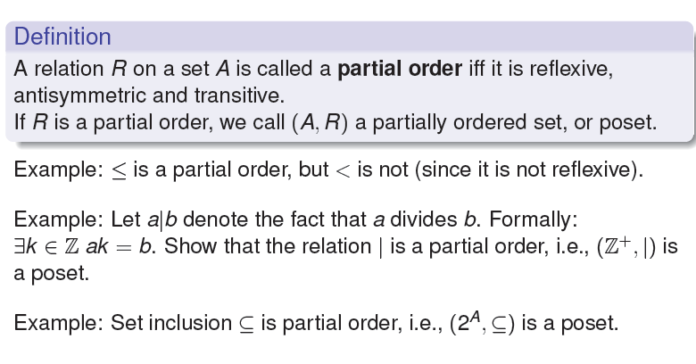
Partial Order

Slide 31
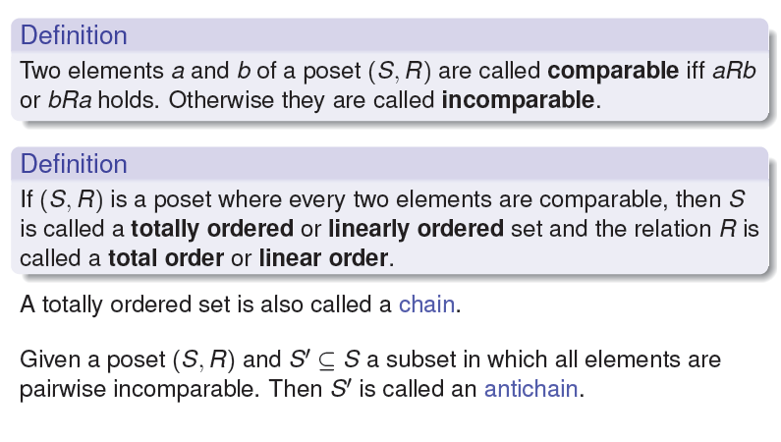
Comparable and Total Order

Slide 32
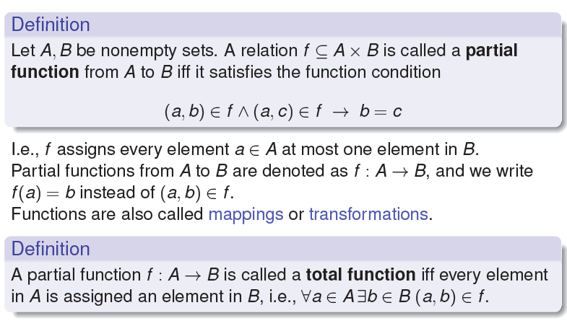
Functions as Relations

Slide 33
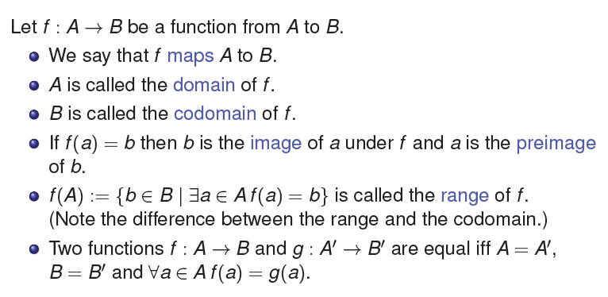
Terminology about Functions

Slide 34
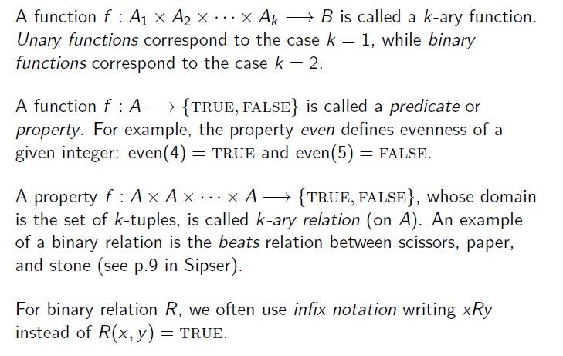
Types of Functions

Slide 35
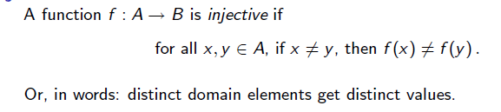
Injective Functions

Slide 36
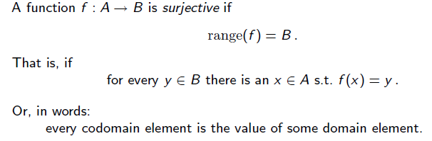
Surjective Functions

Slide 37
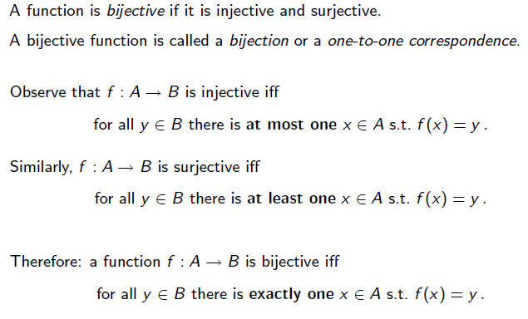
Bijective Function

Slide 38
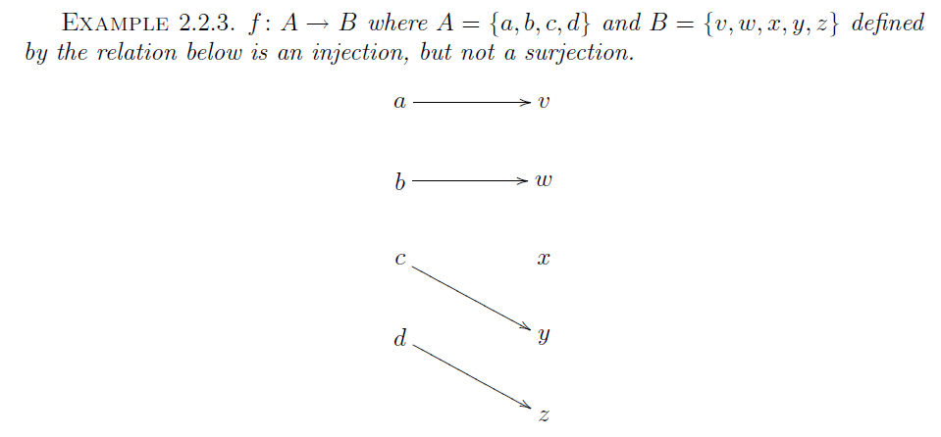

Slide 39
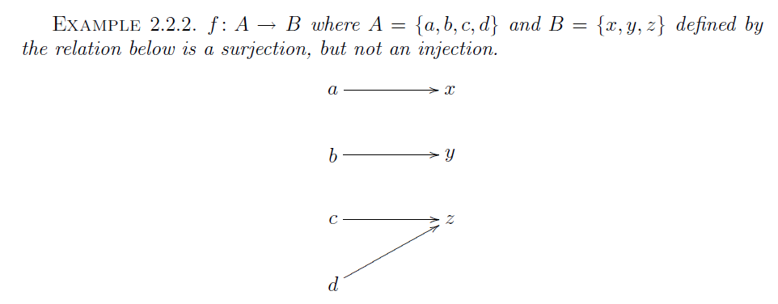

Slide 40
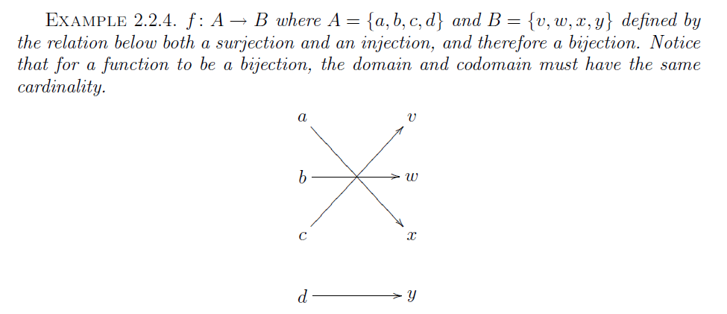

Slide 41
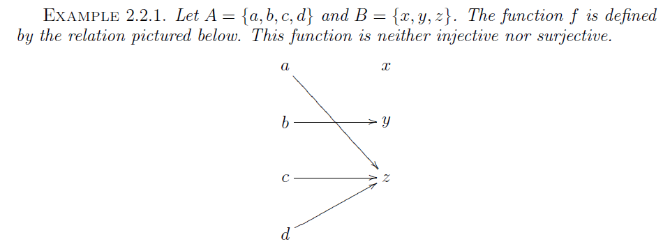

Slide 42
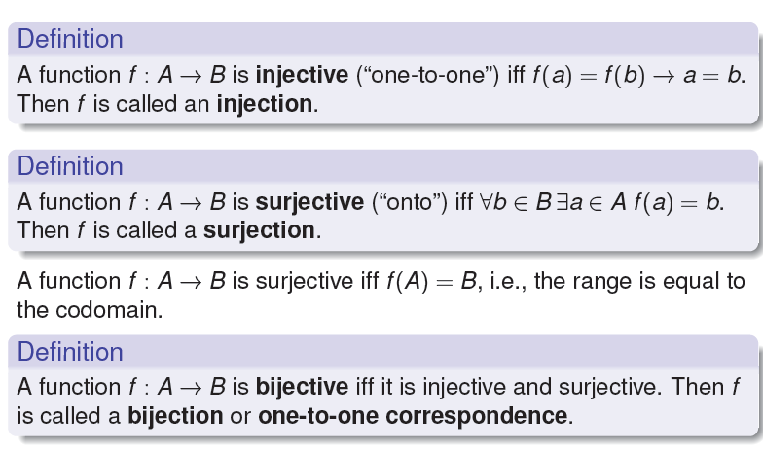

Slide 43
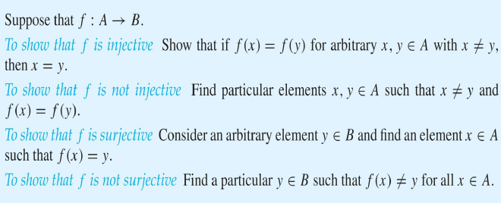
Reasoning about injection/surjection

Slide 44
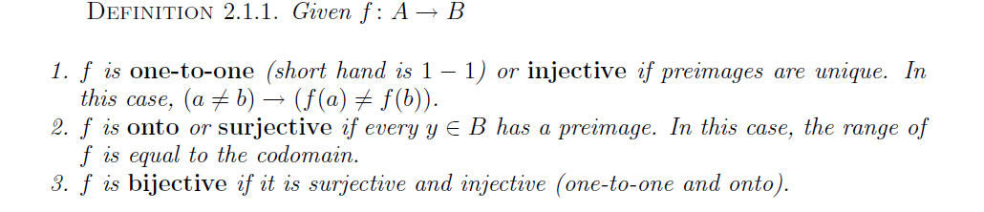
Properties of Functions

Slide 45
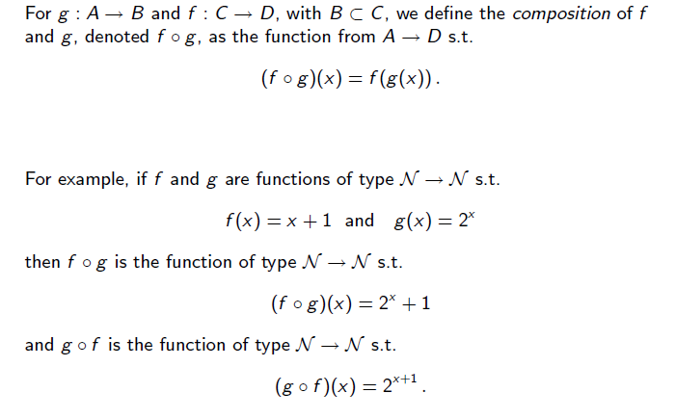
Function Composition

Slide 46
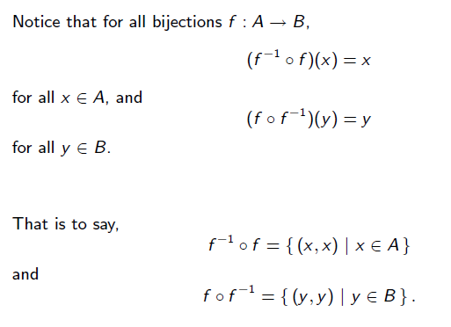

Slide 47
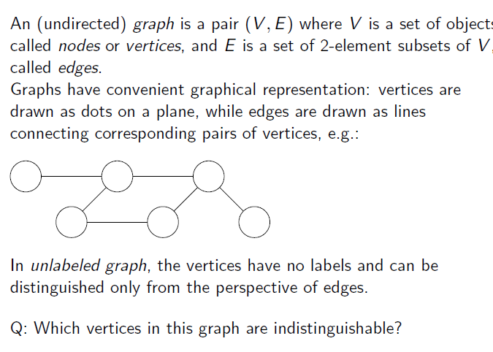
Undirected Graphs

Slide 48
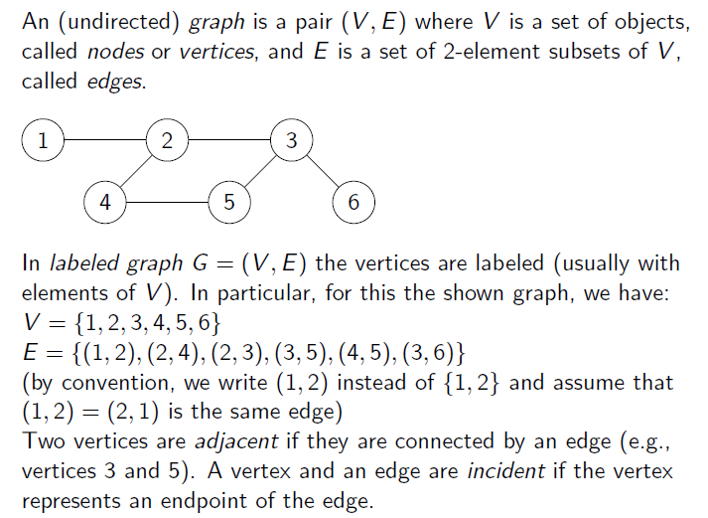
Undirected Graphs

Slide 49
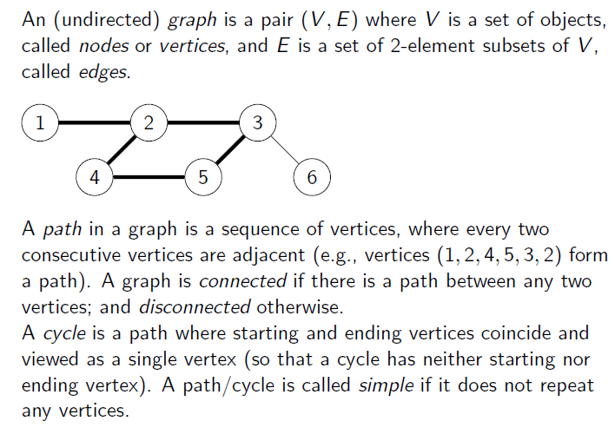
Undirected Graphs

Slide 50
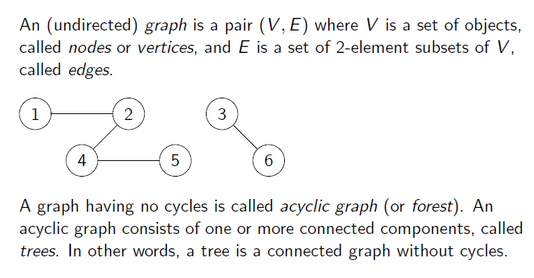
Undirected Graphs

Slide 51
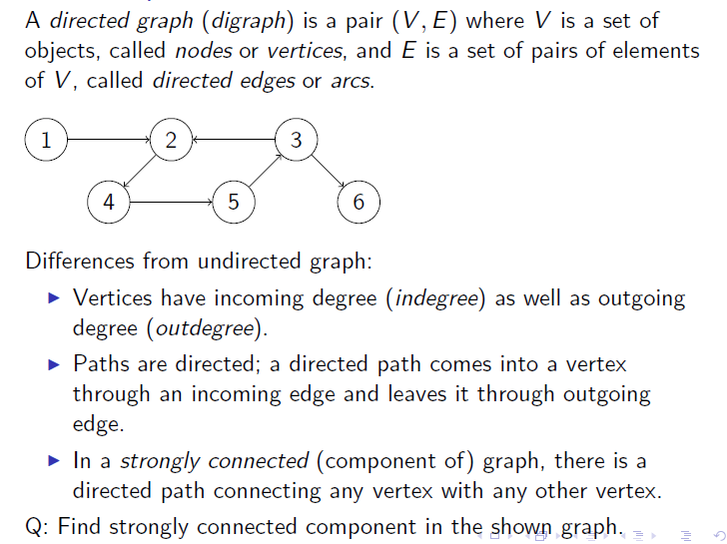
Directed Graphs

Slide 52
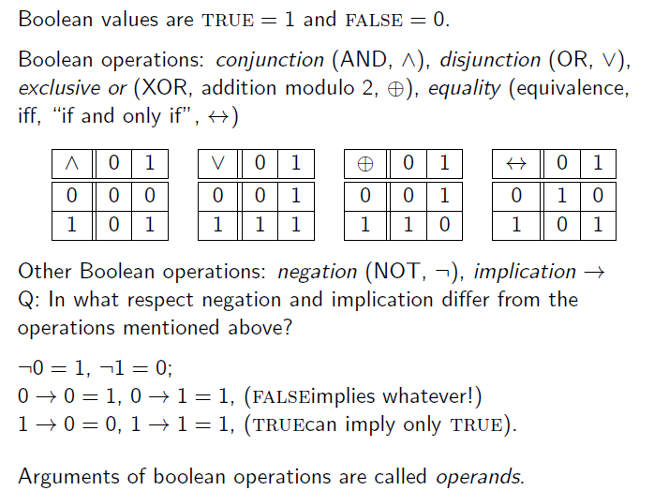
Boolean Operation

Slide 53
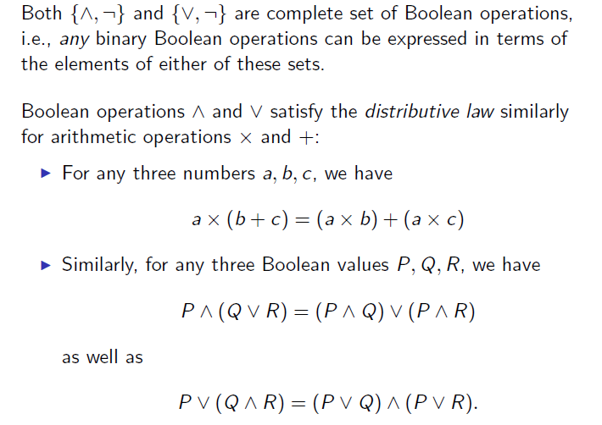
Boolean Operations

Slide 54
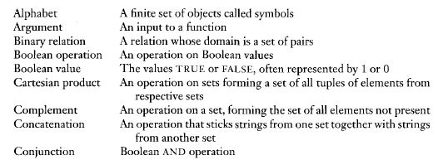
Various operations on sets

Slide 55
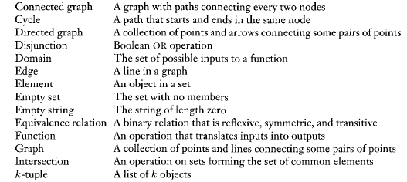

Slide 56
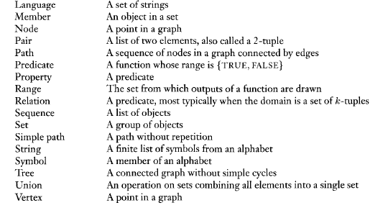

Slide 57
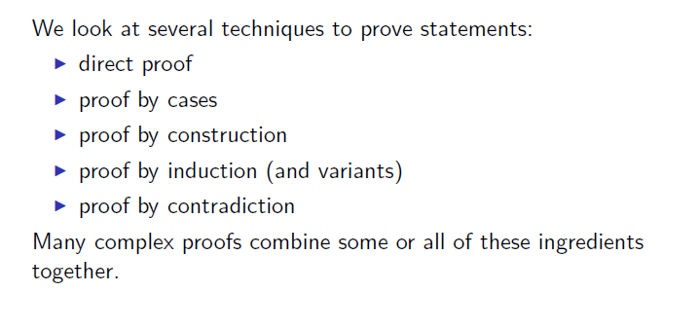
Methods of proof

Slide 58

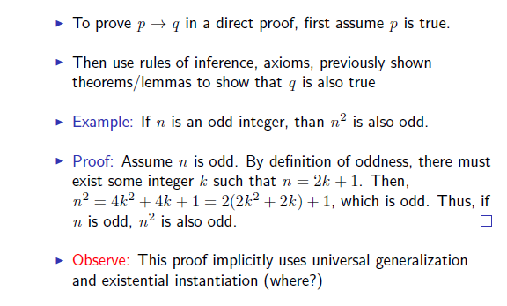
Direct Proof
--------------------------------------------------

Slide 59
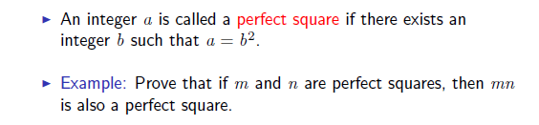
Direct Proof: another example

Slide 60
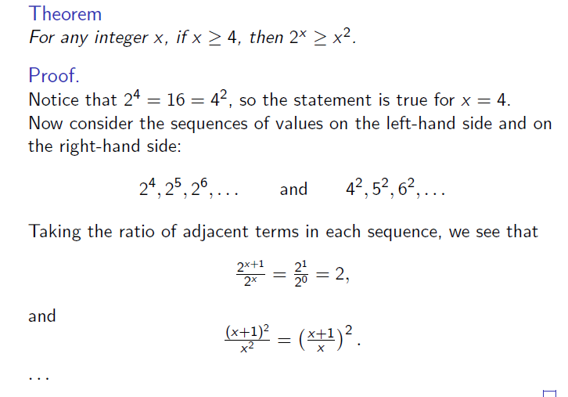
Direct Proofs: example

Slide 61
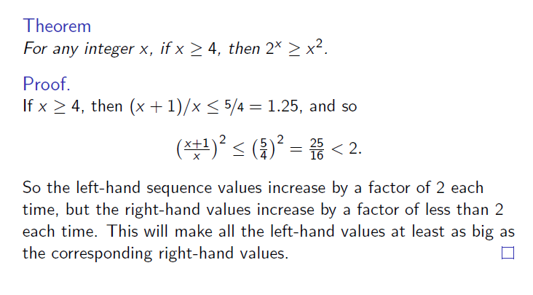
Direct Proofs: example

Slide 62
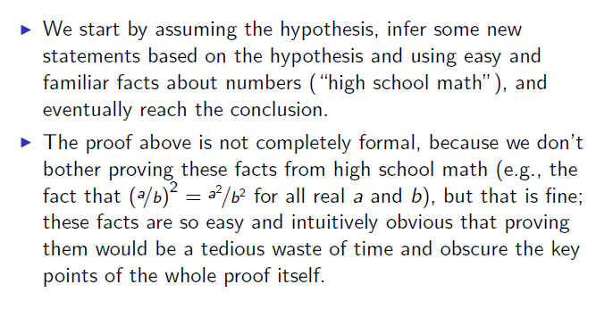
Direct Proofs: features

Slide 63
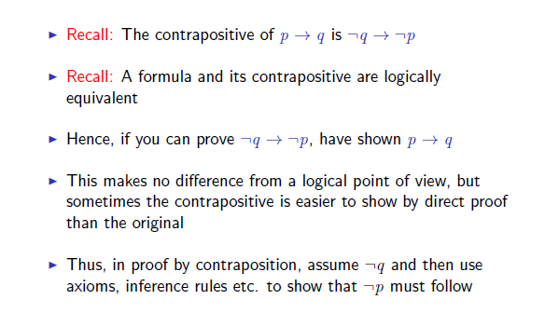
Proof by Contraposition
--------------------------------------------------

Slide 64
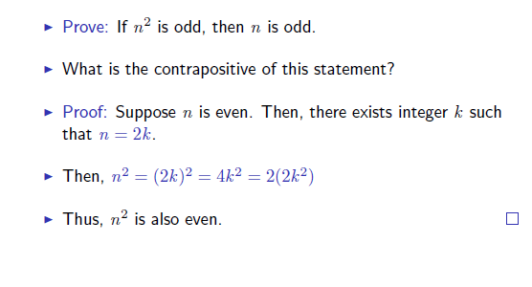
Proof by Contraposition: example

Slide 65
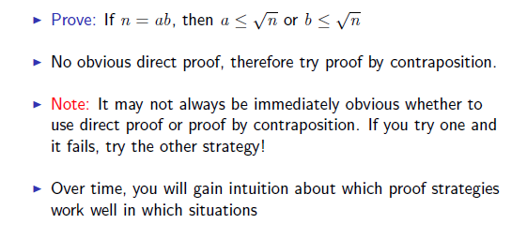
Proof by Contraposition: another example

Slide 66
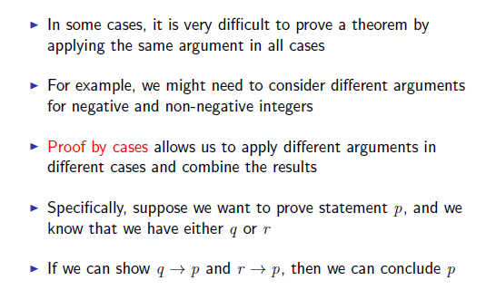
Proof by Cases

Slide 67
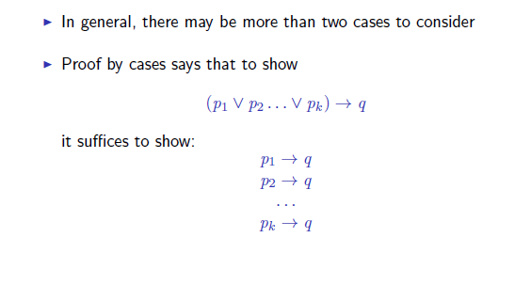
Proof by Cases

Slide 68

Proof by Cases: example 1

Slide 69

Proof by Cases: example 1

Slide 70

Proof by Cases: example 2

Slide 71

Proof by Cases: features

Slide 72

Proof by Construction

Slide 73

Proof by Construction: example

Slide 74

Proof by Induction

Slide 75

Proof by Induction: example 1

Slide 76

Proof by Induction: example 1

Slide 77

Proof by Induction: example 1

Slide 78

Proof by Induction: example 2

Slide 79

Proof by Induction: example 2

Slide 80

Proof by Induction:
The horse paradox is a falsidical paradox

Slide 81
Proof by Contradiction
In one common form of argument for proving a theorem, we assume that the theorem is false and then show that this assumption leads to an obviously false consequence, called a contradiction.
We use this type of reasoning frequently in
everyday life, as in the following example.

Slide 82


Slide 83

Proof by Contradiction: example 1

Slide 84

Proof by Contradiction: example 2

Slide 85

Proof by Contradiction: example 2

Slide 86

Proof by Contradiction: example 3

